Slide 1
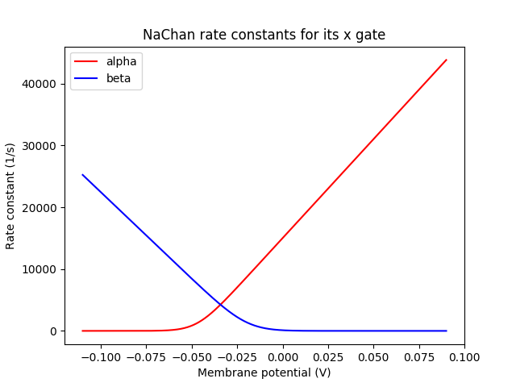
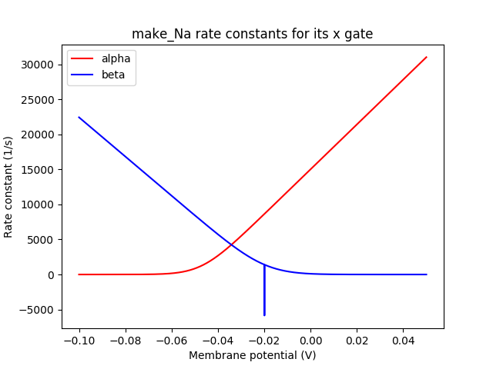
Traub1991 (from Channelprotos.py)
rdesigneurProtos.py

Slide 2
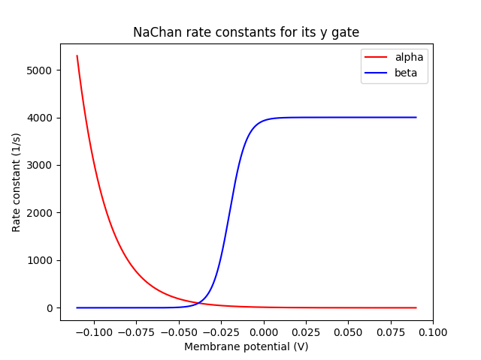
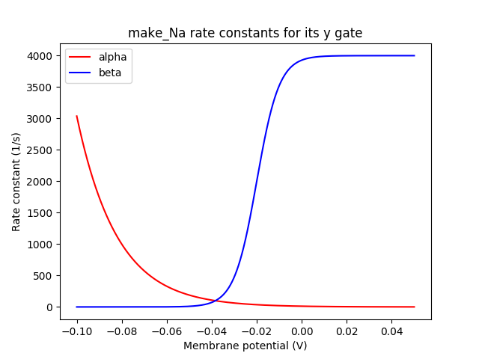
Traub1991 (from Channelprotos.py)
rdesigneurProtos.py

Slide 3
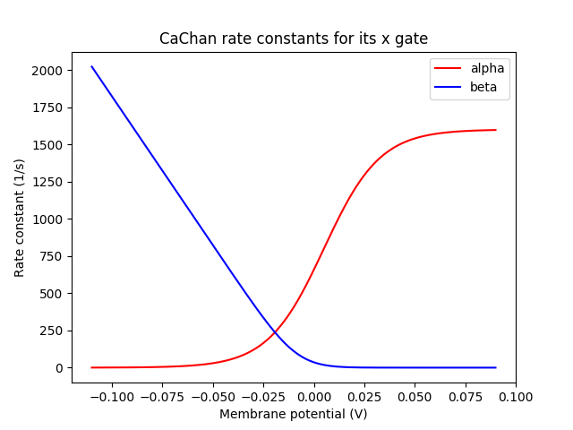
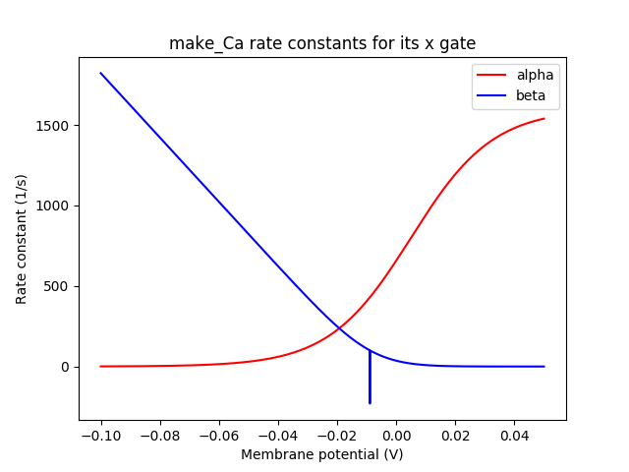
Traub1991 (from Channelprotos.py)
rdesigneurProtos.py

Slide 4
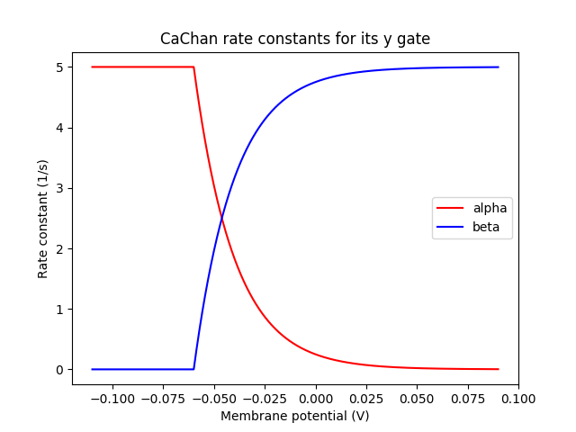
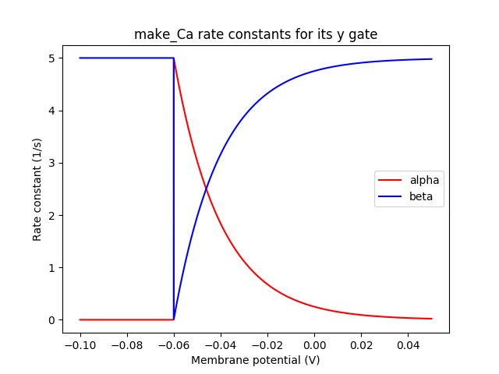
Traub1991 (from Channelprotos.py)
rdesigneurProtos.py

Slide 5
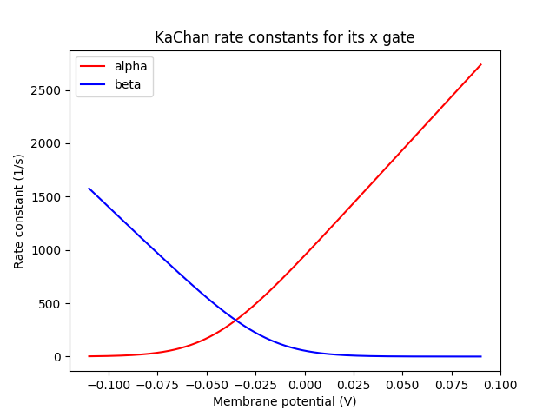
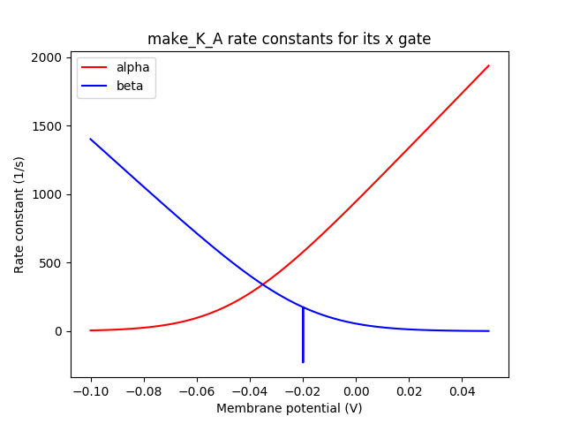
Traub1991 (from Channelprotos.py)
rdesigneurProtos.py

Slide 6
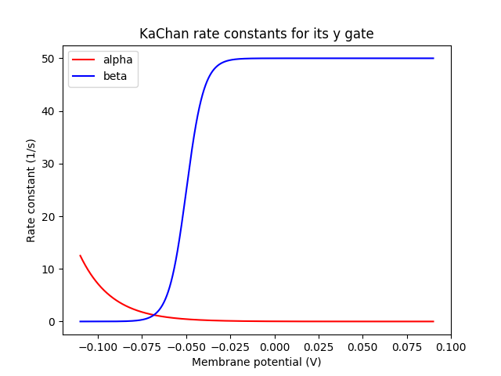
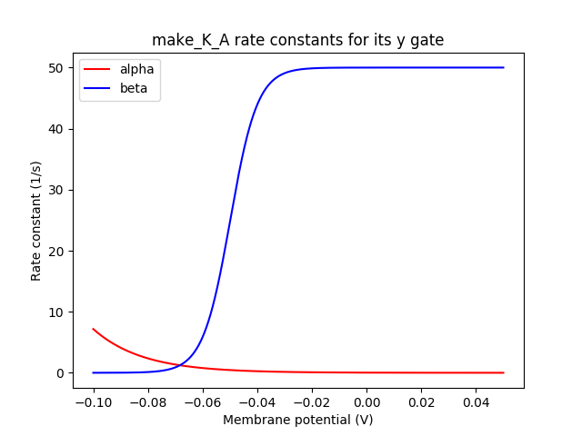
Traub1991 (from Channelprotos.py)
rdesigneurProtos.py

Slide 7
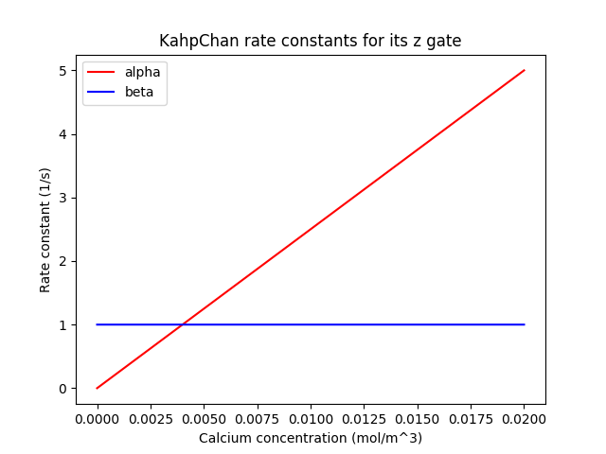
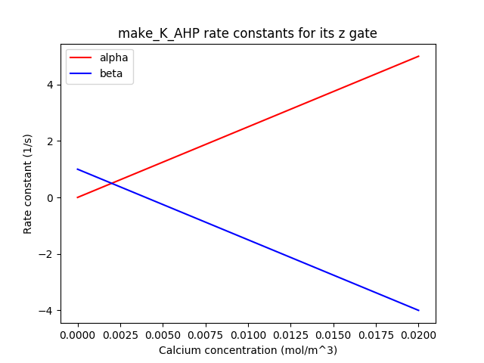
Traub1991 (from Channelprotos.py)
rdesigneurProtos.py

Slide 8
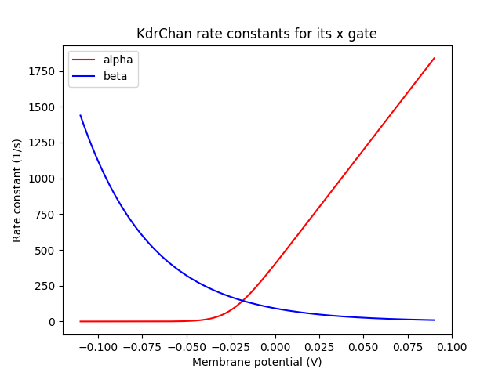
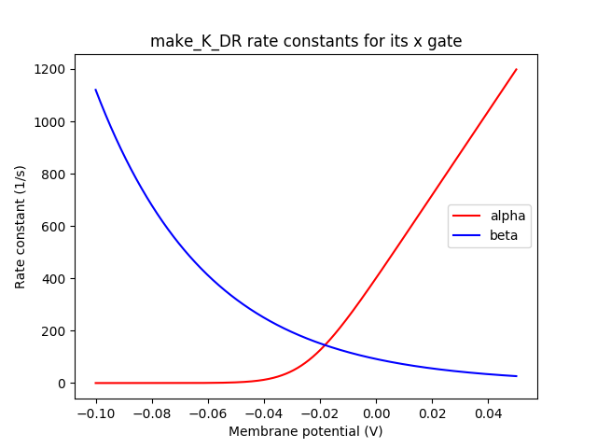
Traub1991 (from Channelprotos.py)
rdesigneurProtos.py

Slide 9
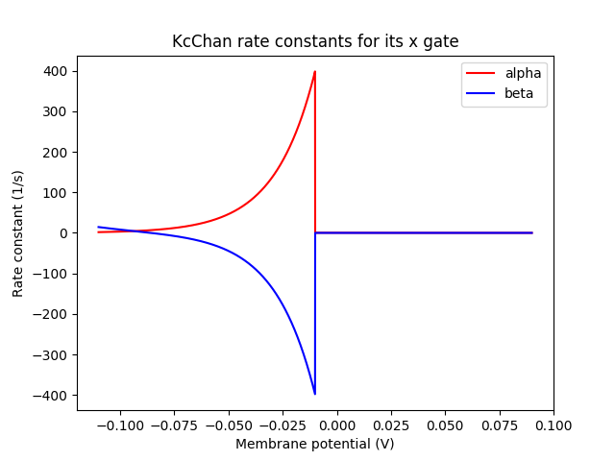
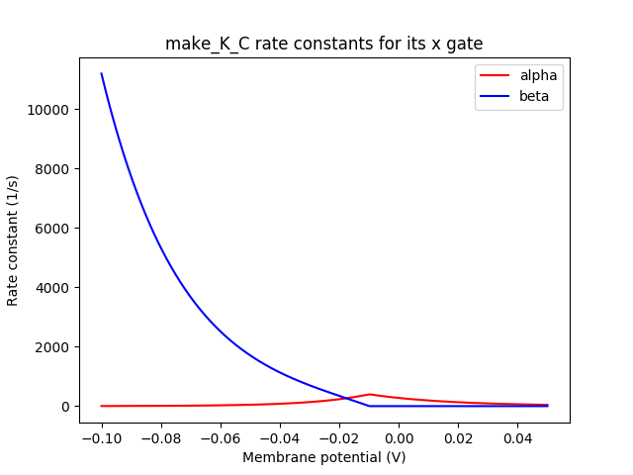
Traub1991 (from Channelprotos.py)
rdesigneurProtos.py

Slide 10
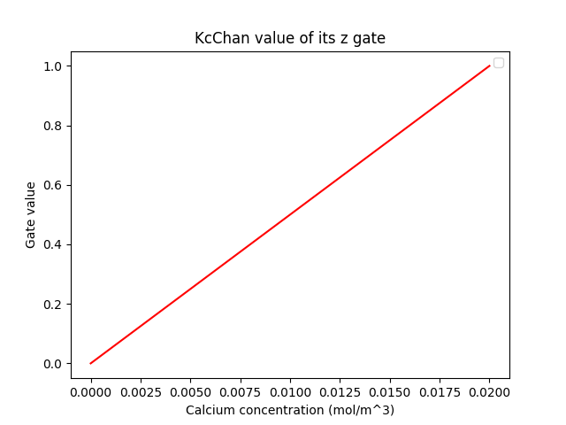
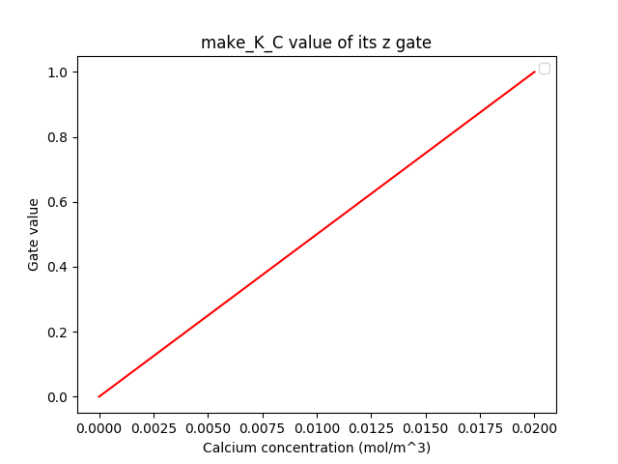
Traub1991 (from Channelprotos.py)
rdesigneurProtos.py

